Slide 1
Nashville Cemetery Project
Adam Crank

Slide 2
Notes:
The most common cause of death of interred individuals was Tuberculosis, which was referred to as “consumption”, in reference to the fact that the disease seemed to “consume” those afflicted, whereas the second most common cause of death was Cholera. Like Tuberculosis, Cholera is a bacterial infection, so it seems like Nashville struggled to cope with bacterial outbreaks in the late 19th and early to mid 20th centuries.

Slide 3
Notes:
Next, looking at the number of burials per year, it appears that the majority of individuals were buried in the later half of the 1800s. The first spike, in the early 1850s. Coincides with a Cholera epidemic that ravaged Nashville’s population starting in 1850, contributing to one of the top causes of deaths of interred individuals. The second, larger spike in number of burials occurred during the mid 1860s, which coincided with several battles of the American civil war, namely the battles of Fort Henry and Fort Donelson, in 1862, and the battle of Nashville in December of 1864, which followed the Battle of Franklin, all four of which were decisive Union victories. Many soldiers from both Union and Confederate armies were interred here at the Nashville cemetery.

Slide 4
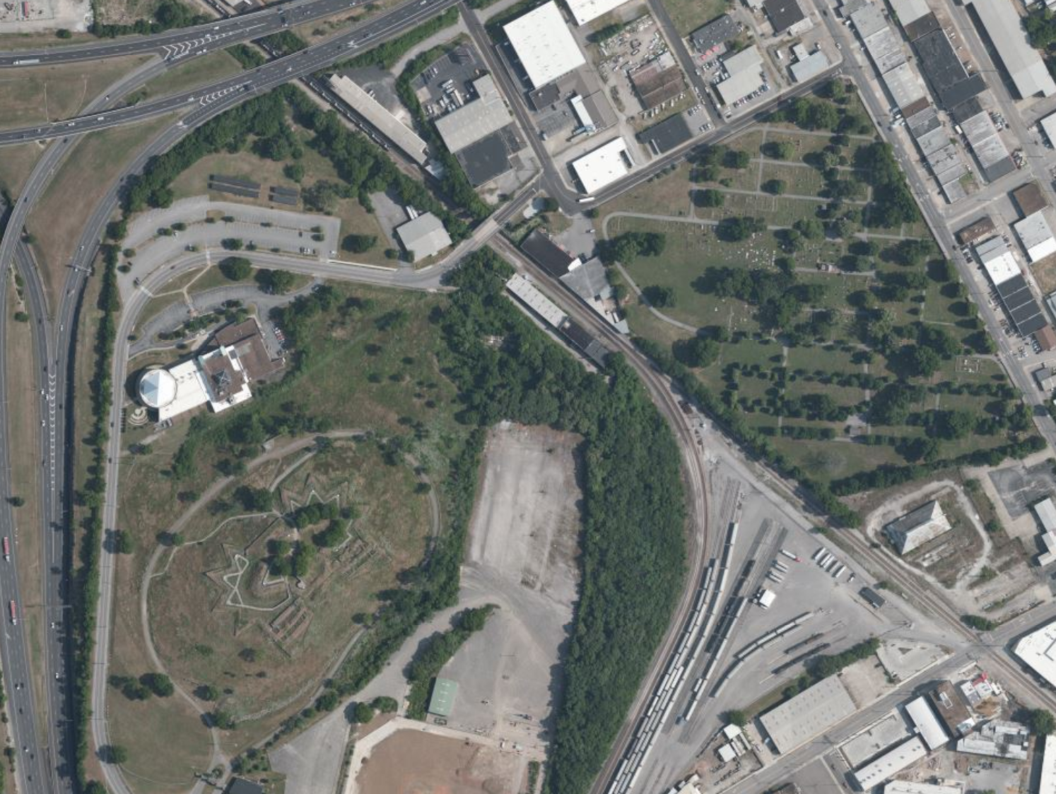
Notes:
In fact, another Civil War era fort, Fort Negley, was constructed by Union forces in 1862 right next to the cemetery, though the fort itself never saw any action over the course of the war.

Slide 5
Notes:
Prior to the 1870s, generally coinciding with the end of the civil war, more men were being buried than women. This is likely a result of an influx of male soldiers being buried, though nearly equinumerous amounts of women were buried as well.

Slide 6
Notes:
In fact, starting in the 1880s, for the most part, the number of women buried at the Nashville cemetery each decade outnumber the number of men, with the only exception being in the 1950s.

